Slide 1


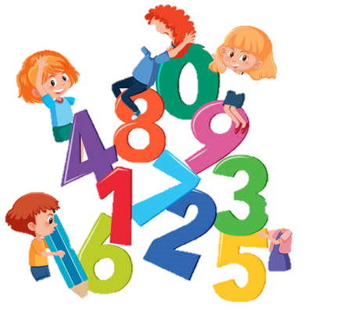
Junior & Senior Infants
Literacy and Numeracy Presentation
10th November 2022

Slide 2
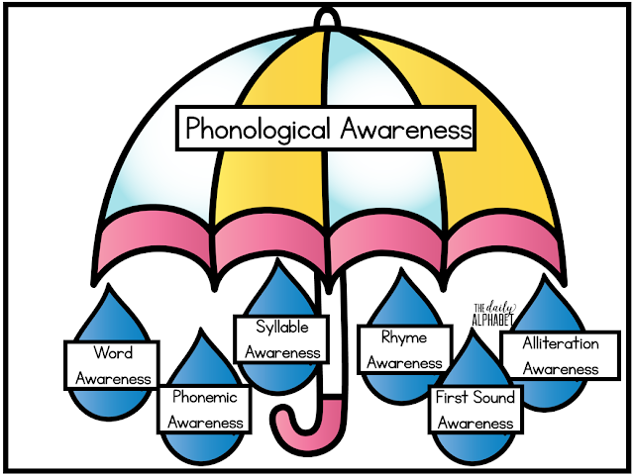
Phonological Awareness
What is Phonological Awareness?
Phonological Awareness is the area of oral language that relates to the ability to think about the sounds in a word, rather than just the meaning of the word. (NCCA, 2019)

Slide 3
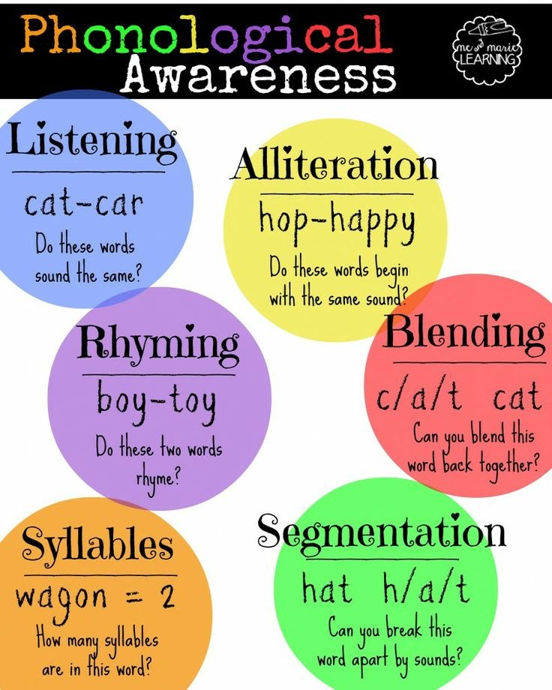
Important Aspects of Phonological Awareness
Recognising that sounds make words and words make sentences.
Identifying words that rhyme, alliteration and identifying syllables in a word.
Hearing sounds within words is an important aspect of literacy. Time should be spent on this at home to reinforce what is being done in school.
Hearing the sounds within words and connecting the sounds to their letter symbols.

Slide 4
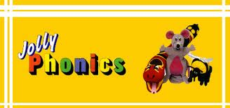
Jolly Phonics
Evidence Based Programme for the instruction of phonics to young children.
Letter names come later - exposure at the beginning of the school year.
Does not follow the alphabet sequentially.
Children learn to read much faster when they know their letter sounds and can work out words for themselves.

Slide 5
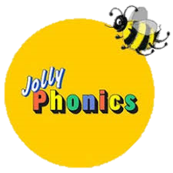
Letter sounds as opposed to letter names.
Multi-Sensory
42 letter sounds
Mix of alphabet sounds (1 sound – 1 letter) and digraphs (1 sound – 2 letters) such as, sh, th, ai and ue.

Slide 6
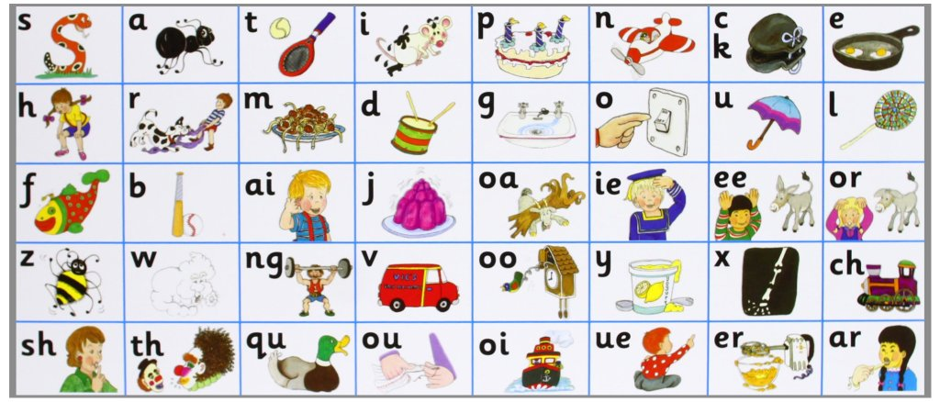

Slide 7
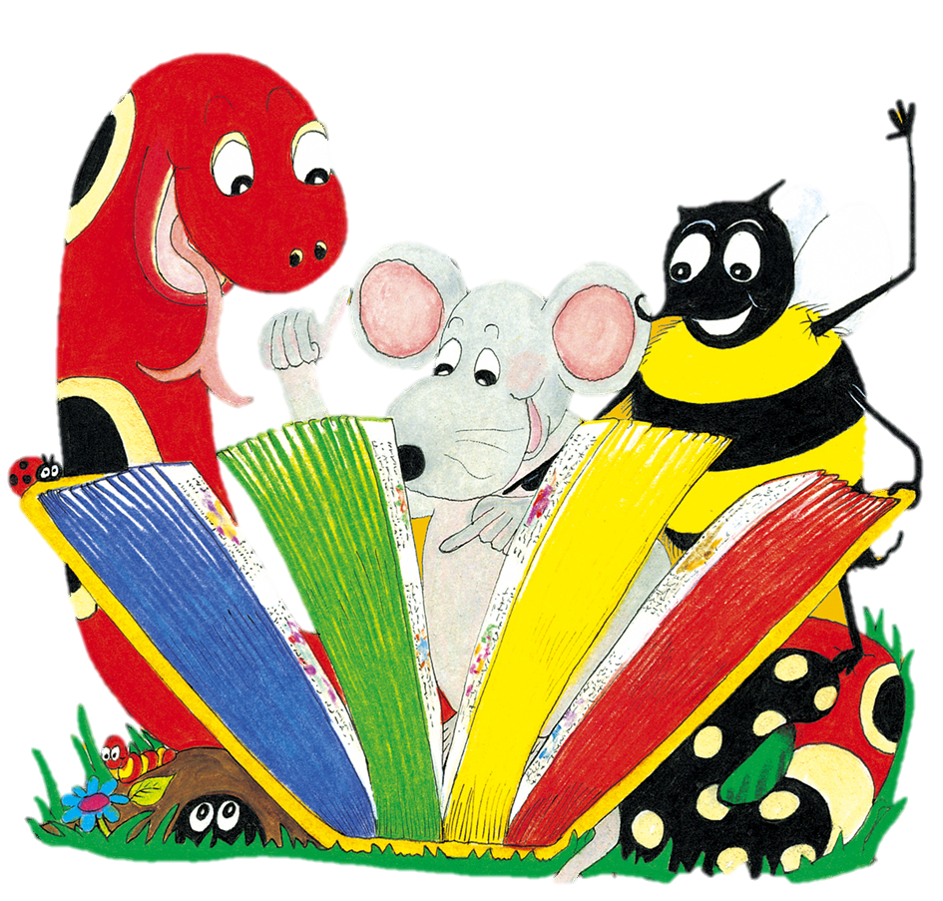
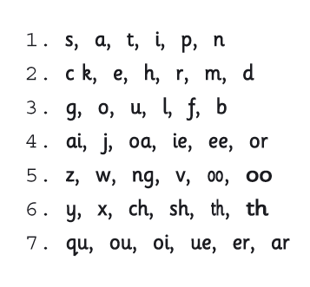
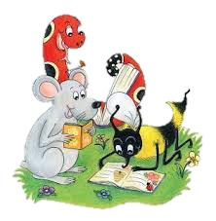
We teach the letter sounds in 7 groups of 6 letters.
The groups are organized in such a way that children can blend the letters to make words once the first group of sounds are known.

Slide 8

Writing
Children spend time on pre-writing skills, such as tracing, scribbling, drawing and mark marking and fine motor skills at the beginning of the year.
Letter Formation-Formal handwriting of the letters begins later on in the year.

Slide 9
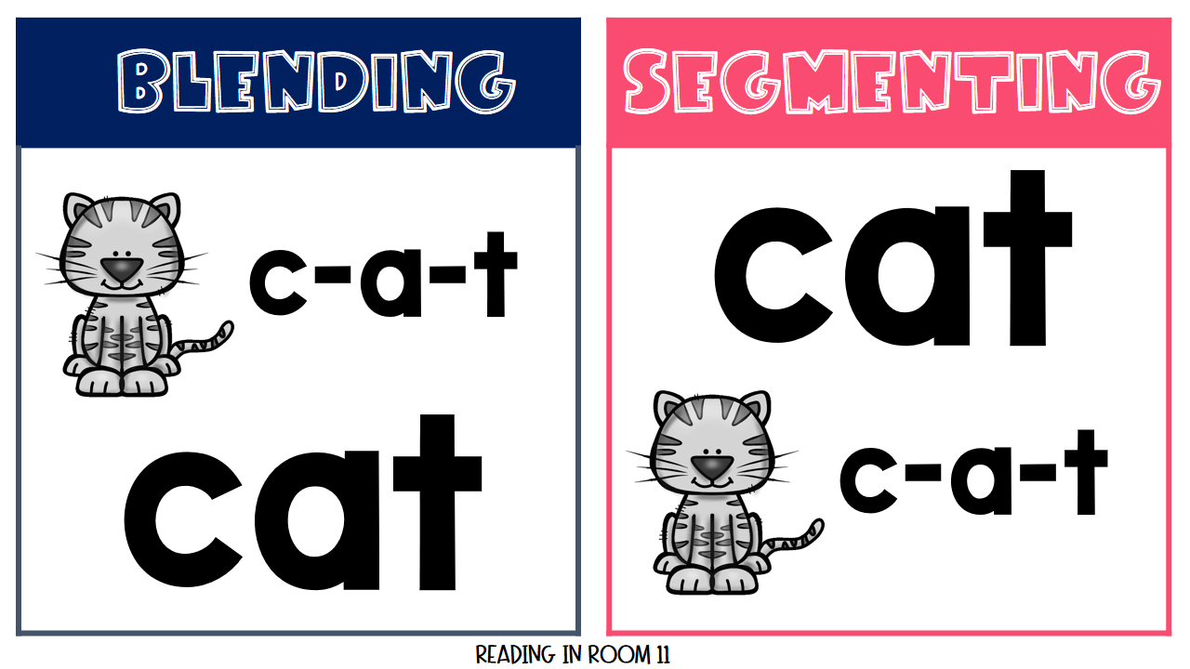
Beginning to Read
Blending-children begin blending the sounds together to help them read and write new words. E.g. s-a-t
Segmenting-breaking down the sounds within words to learn new words/decode words.

Slide 10
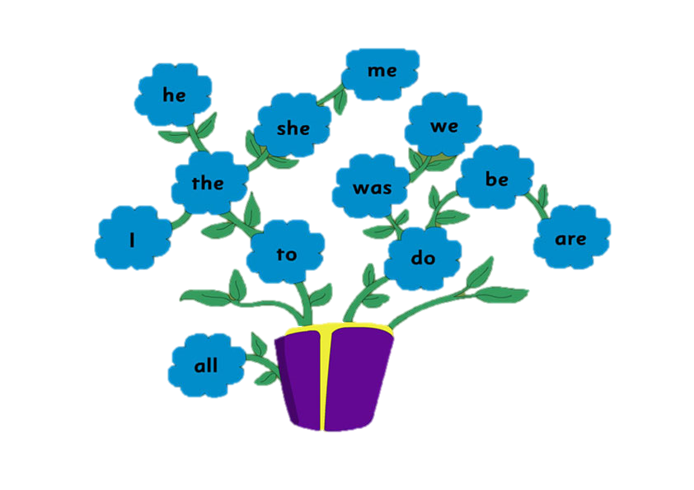
Tricky Words
Tricky Words-These are words with irregular parts, such as ‘who’ and ‘I’, ‘all’, ‘she’. Children learn these as exceptions to the rules of phonics. We begin learning these in term 3.

Slide 11

Shared Reading
Don’t underestimate the importance of reading to your child. Listening to stories develops comprehension, phonological awareness and also helps with the recognition of sight words.

Slide 12
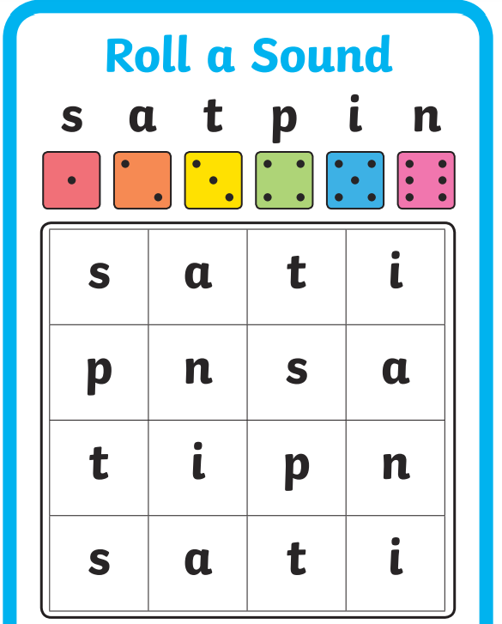
Roll a Sound

Slide 13
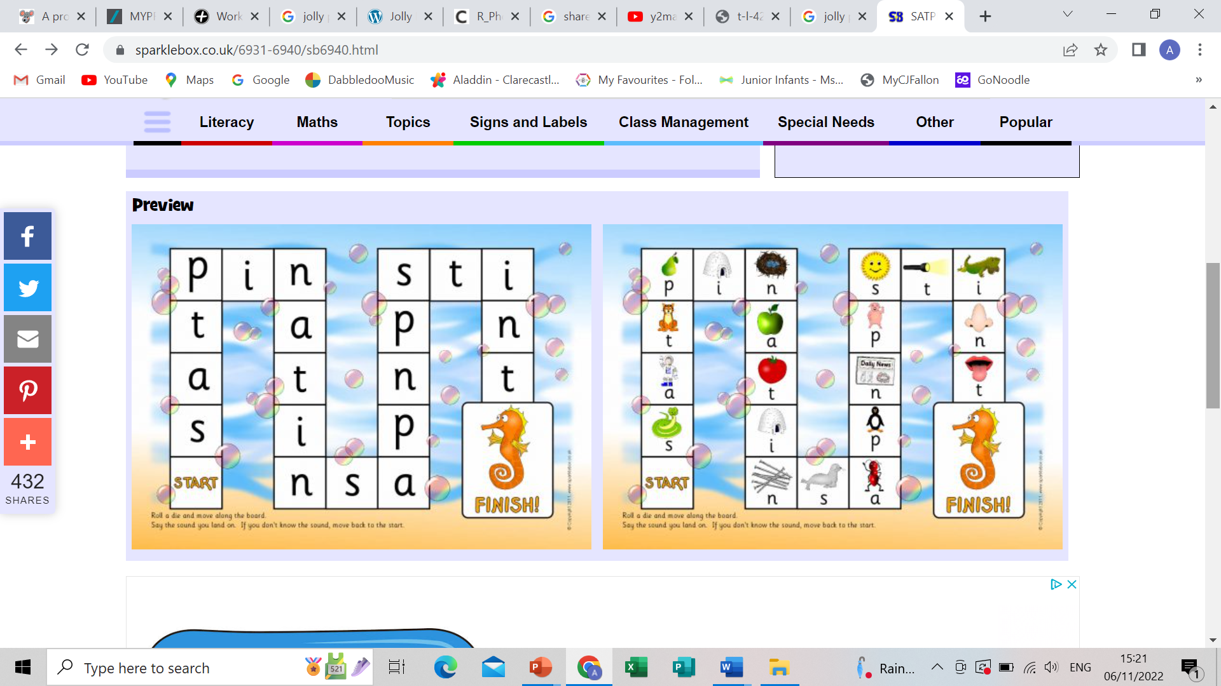
Sounds Board Game

Slide 14
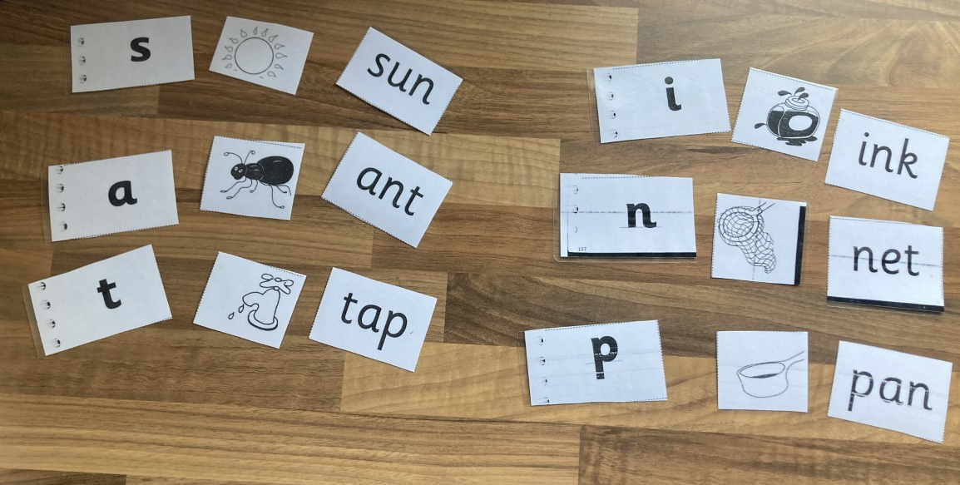
Matching Game

Slide 15
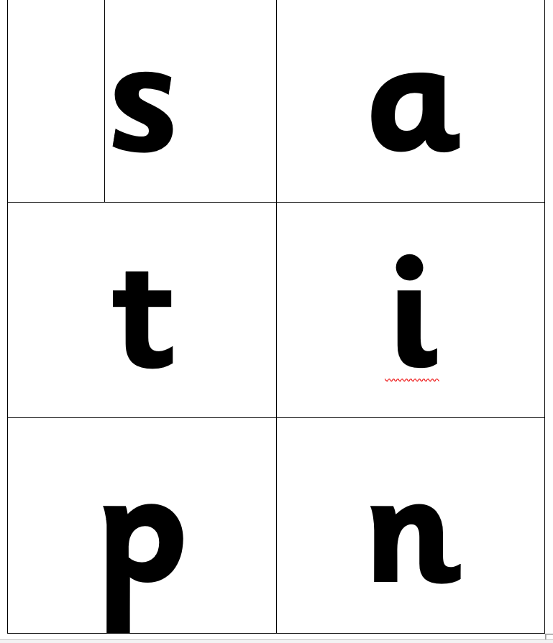
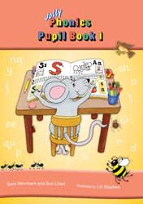
Sound Cards & Jolly Phonics Workbook

Slide 16
References:
NCCA. (2019) Phonological Awareness. Dublin: NCCA.
Griffith, A. (2022) What is phonological awareness?, The Daily Alphabet, available: https://thedailyalphabet.com/what-is-phonological-awareness/ [accessed 6 November 2022].
Reading Connection. (2022) Phonological and phonemic awareness, available: https://sites.google.com/a/uwosh.edu/reading-connection/home/phonemic-awareness [accessed 6 November 2022].
Jolly Phonics. (2022) Jolly phonics, available: https://www.jollylearning.co.uk/jolly-phonics/#:~:text=Jolly%20Phonics%20is%20a%20comprehensive,as%20opposed%20to%20the%20alphabet [accessed 6 November 2022].

